Slide 1
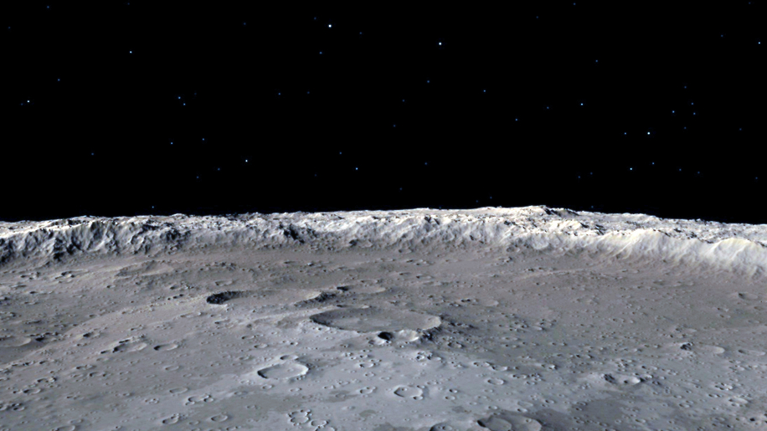

HSML Schema
How to create our own private schema using schema.org
Alicia Sanjurjo Barrio (349B – Affiliate)
12/06/2024

Slide 2
HSML Schema
Create schema with the HSML ontology types
Use existing properties from Schema.org
Create our own custom properties for each type
Use the same identifier as defined in the standard (SWID)
Create examples that follow this schema extension

Slide 3
Spatial Web Ontology Entries
ENTITIES are the base items used across the Spatial Web in HSML
The Spatial Web ontology defines several classes. All classes are types of the Entity base class:
ACTIVITY
AGENT
CONTRACT
CHANNEL
CREDENTIAL
DOMAIN
HYPERSPACE/SPACE
TIME
HSML encodes ENTITIES in a format, e.g., JSON-LD

Slide 4
Agent has goals, senses, and responds, i.e. Lunar Rover
AGENT
Agent is a type of Domain. Agents can also sense other Domains
Activity is an action performed by an Agent
Agent can send messages through
the Channel
i.e. Lander, Rover, Moon surface
A Domain info can be sent through the Channel
CHANNEL
Channel contains messages related to an Activity
i.e. Leave the Lander
DOMAIN
ACTIVITY
A Domain can perform an Activity.
An Activity can be performed on a Domain
Domain references a Hyperspace
A Credential is made by a Domain (domain authority)
A Contract is done for an Activity
Activities take Time to be carried out
A Credential parties to a Contract
CREDENTIAL
CONTRACT
HYPERSPACE
TIME
Notes:
HYPERSPACE: A set of ‘points’ such that, for every ordered pair of points, there is a possibly empty set of ‘paths’ from the first point to the second, and such that there is an ‘identity’ path from every point to itself. Syn: SPACE.

Slide 5
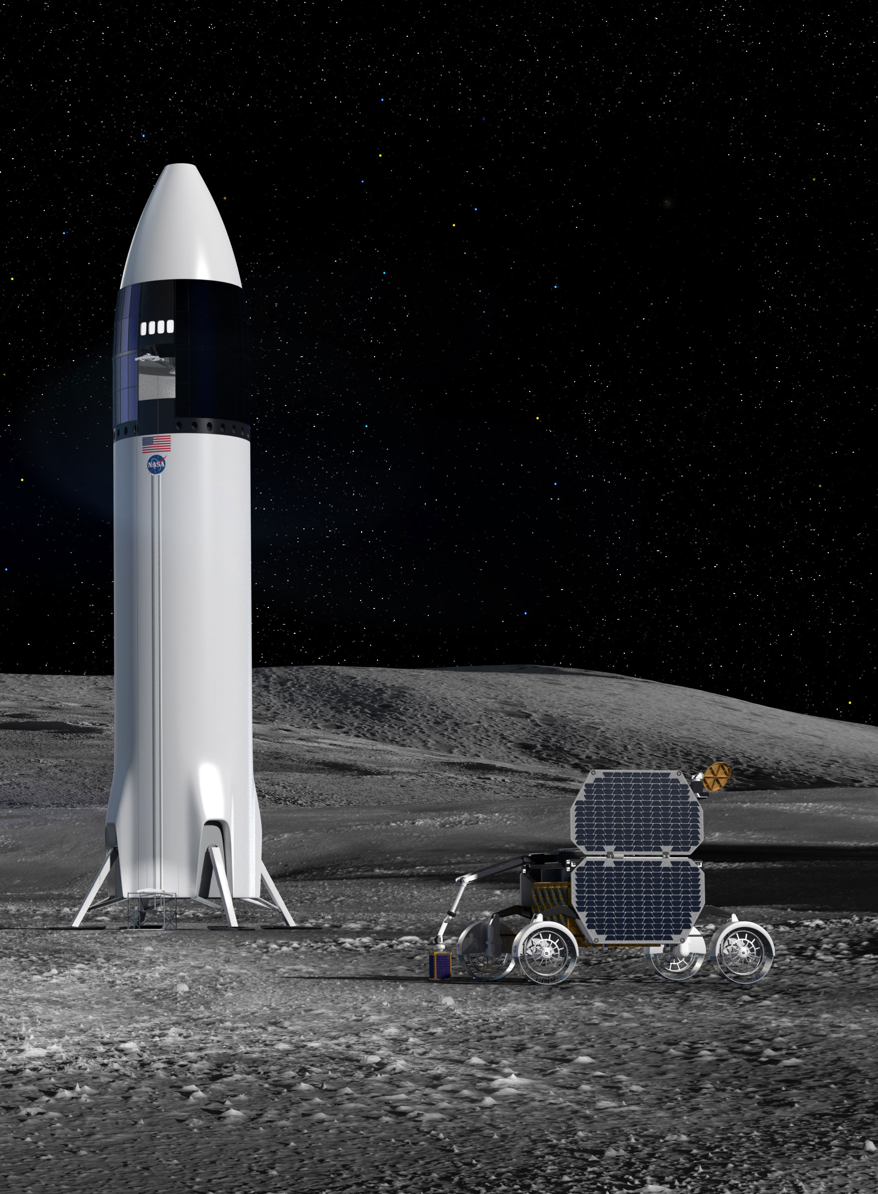
USE CASE:
Two Organizations, Company A and Company B, sign a Contract to work together on a space mission to the Moon.
The Rover of Comp. A will be carried inside the Lander of Comp. B. (Agents)
Once they reach the Moon, the Rover will leave the Lander. To make sure this Activity is developed without any problem, Comp. B needs to work with the model of the Lunar Rover and run some simulations.
A Credential is issued by Comp. A, authorizing Comp. B users (Person) to have access to the 3D Model of their rover for a Period of 3 Months (Time).
The model of the Lunar Rover is in Unreal, and the model of the Lander is in Omniverse; both have a Moon surface environment modelled. The Hyperspace must consider, the location (the Moon), and the appropriate coordinate systems and transforms needed to go from one platform to the other.
All the messages and communications related to this Activity are carried out in a Channel.

Slide 6
Organization: Company A
Channel: Communication between Comp A & B for Activity 1
Organization: Company B
Person: User 1
Person: User 2
Agent: Unreal Lunar Rover 3D Model
Agent: Omniverse Lunar Lander 3D Model
Activity 1: Leave the Lander
Credential: Ownership by Comp. A
Contract: Between Comp. A & B for Activity
Credential: Ownership by Comp. B
Credential: For Comp. B to use temporally Lunar Rover
Hyperspace: Moon, Coordinate System, Transform Unreal-Omniverse
USE CASE
Time: Period of 3 Months
Time: Activity Duration

Slide 7
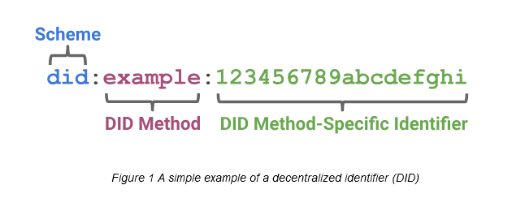
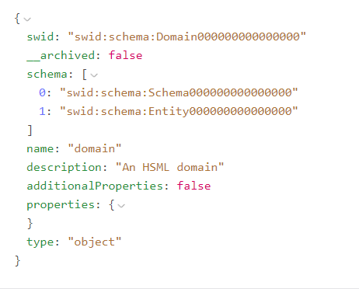
Attributes of HSML ENTITY
Identifiers – SWIDs¹ that conform to W3C did-core, https://www.w3.org/TR/did-core/.
Name
Description
Links to other ENTITIES
Properties
Type: either “ENTITY” or one of the eight semantic entities in the Spatial Web ontology
All HSML objects derive from the Entity class.
¹SWID ≡ Spatial Web Identifier

Slide 8
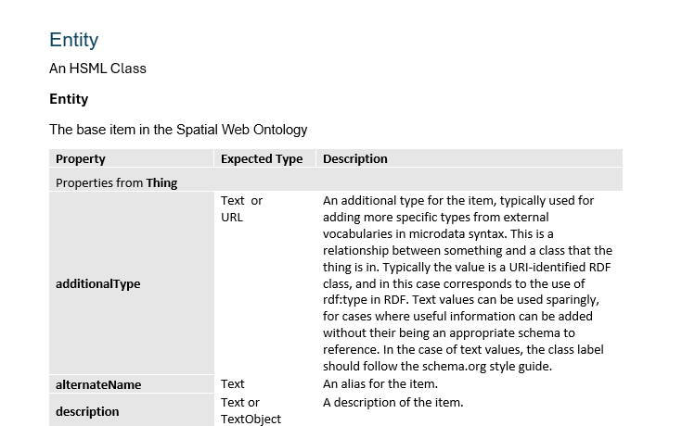
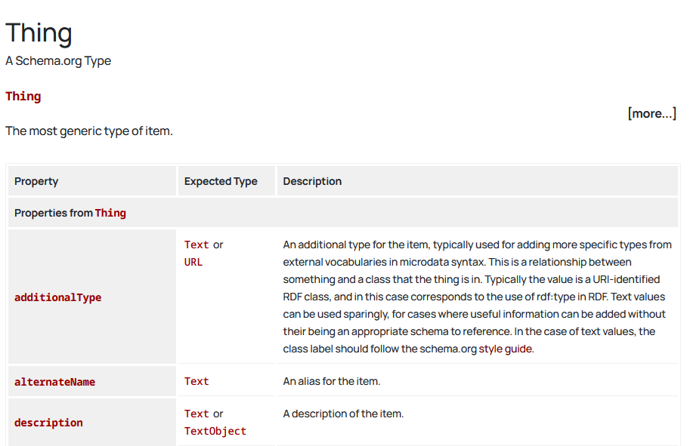
HSML Types Structure
Document currently under construction
Schema.org webpage

Slide 9
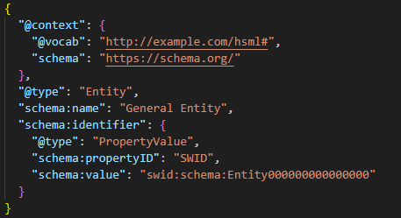
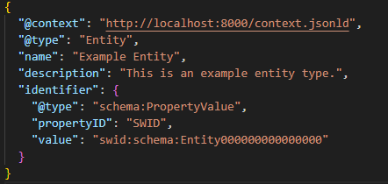
HSML Schema Examples
Entity
Agent (using modified Jared’s 3DModel)
Credential (that could be used for access)

Slide 10
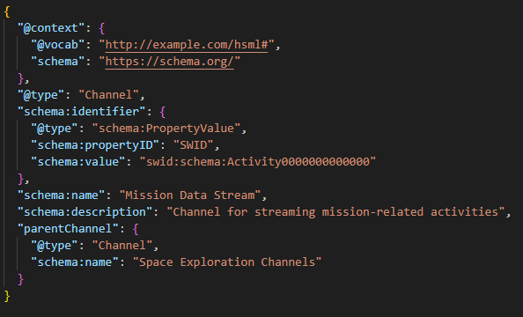
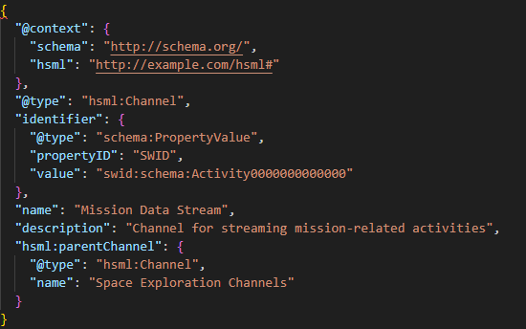
HSML Schema Context (1/2)
2 options:
1. Typing schema for Schema.org properties & types
2. Typing hsml for our properties & types
Placeholder for public namespace: http://example.com/hsml#

Slide 11
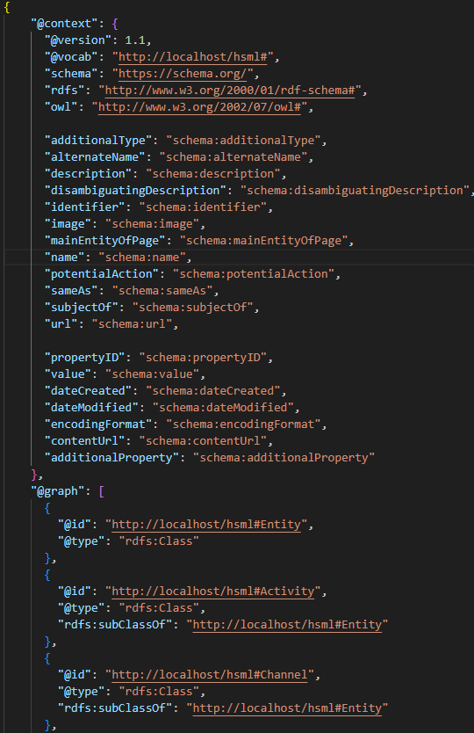
HSML Schema Context (2/2)
HSML schema context.jsonld file stored in a local server for now
The schema.org properties are mapped inside context.jsonld to an equally named HSML property for simplicity
Entity Example
[…]

Slide 12
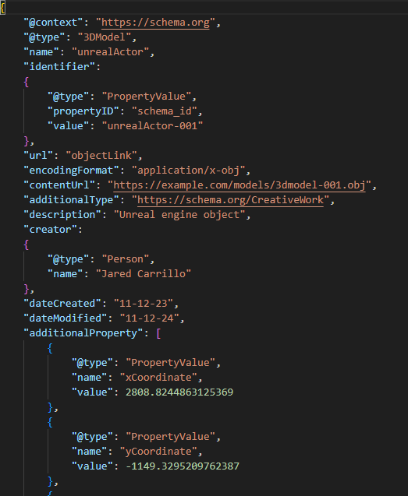
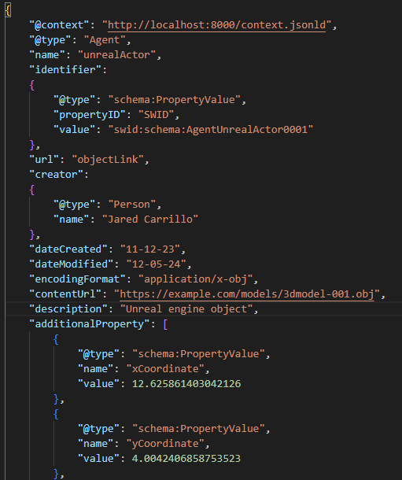
Agent Example: kafkaUnrealProducer from Jared:
Before: Using only schema.org
Now: Using new schema

Slide 13
Agent Example: kafkaUnrealProducer from Jared:
Before: Using only schema.org
Now: Using new schema

Slide 14
Questions & Concerns
In the future, to store our HSML schema, we need to purchase a domain, e.g. https://schema.jpl.hsml.org. What is the Procedure to do this within JPL?
In the meantime, we have a few options:
More Private:
Option A: Use a local namespace or an arbitrary URL in the context of the JSON files. Each user needs to have the context stored locally or accessible through Google Drive.
Option B: Store the schema context JSON-LD file in AWS S3 or Google Cloud Storage. They can provide URLs that are either public or accessible only to users with the proper permission
More Public:
Option C: Use GitHub pages or a web server to have publicly accessible JSON-LD file.

Slide 15
ADDITIONAL SLIDES

Slide 16



Spatial Web Protocols
HSML ≡ Hyperspace Modeling Language
A multi-dimensional ontology for encoding fundamental elements and the relationships between them.
HSTP ≡ Hyperspace Transaction Protocol
A multi-dimensional range query for governing the interactions between actors and assets
HSQL ≡ Hyperspace Query Language
Syntax for performing predictive (probabilistic) queries on a vector graph document database which combines comparative, relational, and similarity searching

Slide 17
HSTP in Simple Words
HSTP ≡ Hyperspace Transaction Protocol
System designed to enable smooth, decentralized, secure, and private communication
Focuses on transactions (exchanges of information or actions)
The HSTP Objects are "units of activity". Each object represents an action or event (called an HSML Activity)
Allows different Spatial Web nodes to exchange messages and stay coordinated.
HSTP does for the Spatial Web as HTTP does for the WWW

Slide 18

HSTP & HSML for Kafka
Kafka Integration: Create protocols for authentication and authorization aligned with HSTP principles.
Authentication of users required to access the server
Can use SSL/TLS or SASL
Authorization needed to participate in different channels
Kafka Topics with restricted access using ACLs.
Message Content: Kafka messages would carry data structured in HSML
Possible resources to consider:
https://medium.com/@bhattchitrangna/securing-your-kafka-a-beginners-guide-to-kafka-security-ab2978a4d82e
https://www.redpanda.com/guides/kafka-cloud-kafka-authentication
https://developer.confluent.io/courses/security/authorization/
https://docs.confluent.io/platform/current/security/authorization/acls/overview.html

Slide 19
HSML in Simple Words
HSML ≡ Hyperspace Modeling Language
A modeling language that can be read by both humas and machines
A detailed schema/map that explains how all the different data is related to each other in the system
It describes objects, relations, actions, activities and their permissions
HSML does for the Spatial Web as HTML does for the WWW

Slide 20
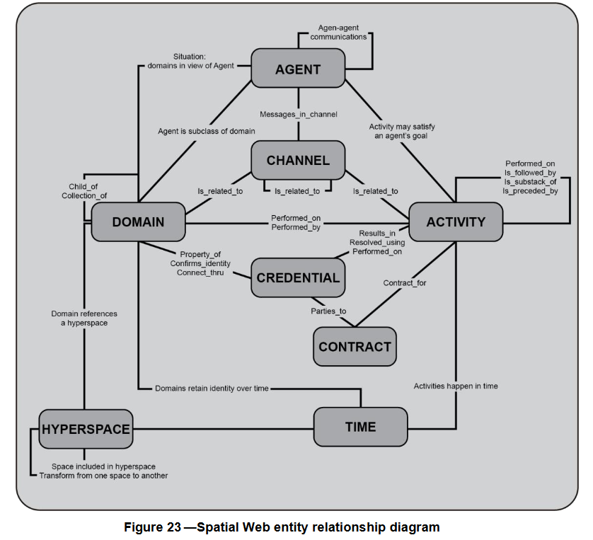
From P2874/D3.1, June 2024 Draft Standard for Spatial Web Protocol, Architecture and Governance:

Slide 21
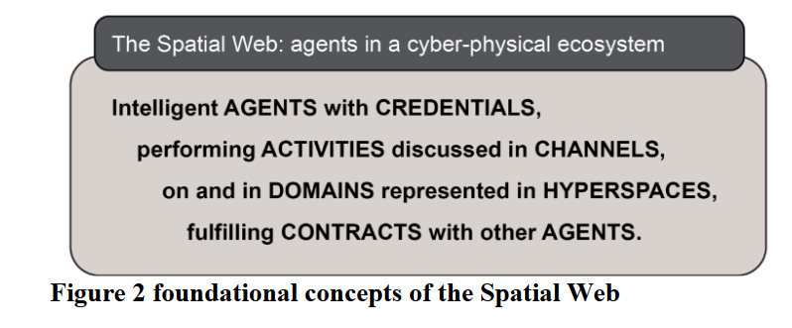
In summary,
From 979-8-3503-5597-0/25/$31.00 ©2025 IEEE,
Enabling Interoperable Digital Twins for Collaborative Lunar Exploration

Slide 22
CHANNEL
CHANNEL: A stream of HSML Entities that are related to an Activity of a specific context that does not itself warrant a Domain or hierarchy. A Channel contains HSML messages that relate to an HSML Activity.
A CHANNEL may be a collection of CHANNELs, where the wider CHANNEL will contain all information from all lower CHANNELs.
Kafka: Can we do topics contained in other topics?
CHANNEL be specific to a specific ACTIVITY or ACTIVITIES.
Kafka: have a topic destined for each Activity or collection of related Activities, where the corresponding Activities and Contracts are talked about, granted access to other Agents…
CHANNEL be specific to a specific AGENTS based on CREDENTIALS
Kafka: For each 3D Model, we have a topic. The access to subscribe to this topic will be done through a credential

Slide 23
DOMAIN Types
There are 6 types of Domains:
Geographic — ex: Moon surface
Concept — ex: Planetary Protection
Organization — ex: a JPL team workplace
Agent — ex: a physical rover, a digital twin, a lander
Person — ex: a human person, astronaut
Thing — ex: lunar rocks, the lander’s platform

Slide 24
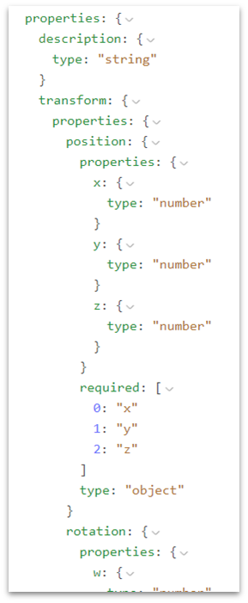
SPACE Properties
There are different properties that can define a SPACE:
description
transform
position (xyz)
rotation (xyz)
volume (xyz)

Slide 25
Channel 1
User 1
User 2
Channel 2
User 3
User 4
Channel 3
User 5
User 6

Slide 26
Use Case:
Organization (Domain)
Channel
Organization (Domain)
Company A
Comm. Channel Comp A & B for Activity 1
Company B
Person
(Domain)
User 1
User 2
Person
(Domain)
Activity
Activity 1: Leave the Lander
Unreal Lunar Rover 3D Model
Omni Lunar Lander 3D Model
Agent
(Domain)
Agent
(Domain)
Contract between Comp. A & B
Credential of Lunar Rover for Com. B to use temporally
Contract
Hyperspace
Credential
Time
Moon, Coordinate System, Transform Unreal-Omniverse
Period of 3 Months

Slide 27
Spatial Web Safety and Security
“Safety & Trustworthiness in the Spatial Web is enabled by Governance”
Credentials, Norms & Contracts are the main concepts for Governance
Credentials – used for authentication and identity – who can access a domain, and how can they interact with it
Norms – act as a principle of conduct or right action over domains
Contracts – binding agreement used to dictate activities and relationships among domains
4 aspects of trust between parties intermediated by digital technologies:
Authenticity – SWIDs (unique identifier)
Integrity
Confidentiality – HSTP
Privacy – Design principle

Slide 28
Credentials in Kafka
Verifying credentials, identities, and access rights requires a combination of cryptographic techniques, authentication protocols, and access control mechanisms.
Credential Verification: Use VCs, DIDs, JWTs or ACLs.
Domain Identity: Use DIDs.
User Access Control: Check ACLs, DID VCs, or JWT tokens.
Domain Capabilities: Check DID Documents, VCs, or API responses
Credential Verification, Domain Identity, and Access Control in Kafka:
Issue Decentralized Identifiers (DIDs) for producers, consumers, and brokers.
Use Verifiable Credentials (VCs) to grant roles like "producer" or "consumer" for specific topics.
Authenticate users using DID-Auth (challenge-response).
Check role-based access for producers/consumers.
Use encryption and signing for message confidentiality and integrity.

Slide 29
SWID – DID (Decentralized Identifier)
The Spatial Web Identifier (SWID) is a Decentralized Identity (DID), so it does not rely on central authorities, it is a self-sovereign identity.
The unique identifier is generated through a cryptographic process, this makes it impossible to guess the underlying key or DID
How this would work with Kafka:
To create a DID – use app or a CLI tool (can build a CLI tool with python)
Tool generates a key pair (public + private key)
Creates DID from the public key (like did:key:xyz123)
Your private key stays secret, and the DID becomes your public identifier

